Slide 1
KDD Cup 98
Student: Thao Le
Mentor: Jamin Atkins
October 2017

Slide 2
Data Introduction
Data set taken from The Second International Knowledge Discovery and Data Mining Tools Competition, held in conjunction with KDD-98 The Fourth International Conference on Knowledge Discovery and Data Mining.
Data set is the Training set used in the competition. It includes:
95412 rows, 481 columns
Each record has a unique identifier, personal attributes, and donation history.
Each record has two target/dependent variables:
TARGET_B: binary variable indicating whether or not the record responded to the promotion of interest ("97NK" mailing)
TARGET_D: contains the donation amount (dollar) and is only observed for those that responded to the promotion.
Objectives:
Predict who are donors (classification problem)
Predict donation amounts for those who are predicted to donate (regression problem)

Slide 3
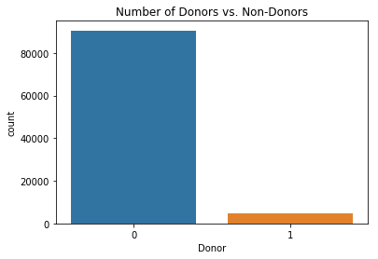
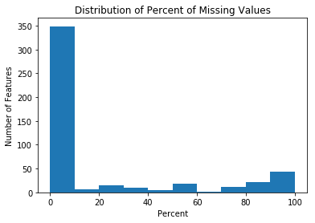
Challenges With the Data Set
Imbalanced data: response rate is only 5%
→ Created a balanced subset, including all records with positive labels and a subset of the records with negative labels
25% of the features have >30% missing values
Dropped all these features
Imputed missing values in the remaining features
Too many features
→ Applied variance threshold and recursive feature elimination for feature selection

Slide 4
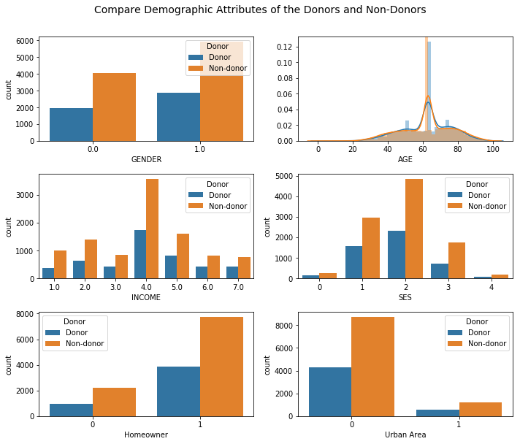
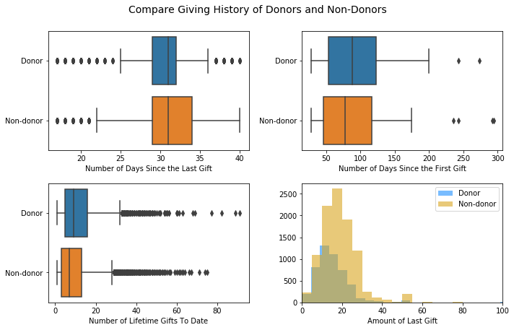
Exploratory Data Analysis
No big differences in demographic attributes and donation history between donors and non-donors

Slide 5
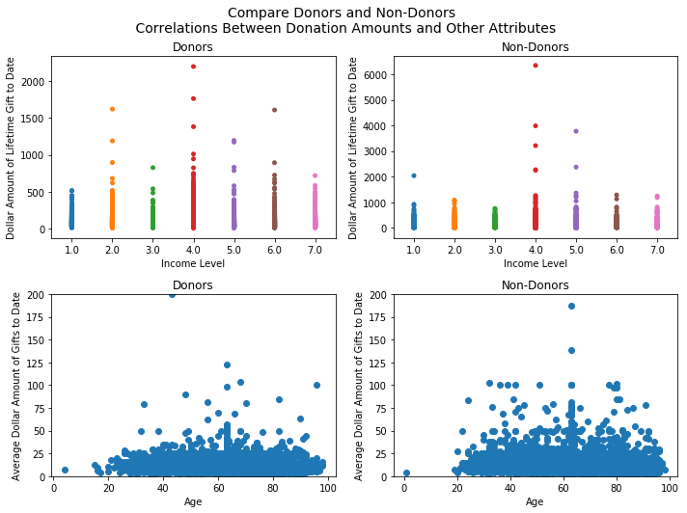
Exploratory Data Analysis (cont.)
Donors seem to have higher total donation amounts to date than non-donors across all income levels.
No correlation between age and average donation amount to date for both donors and non-donors.

Slide 6
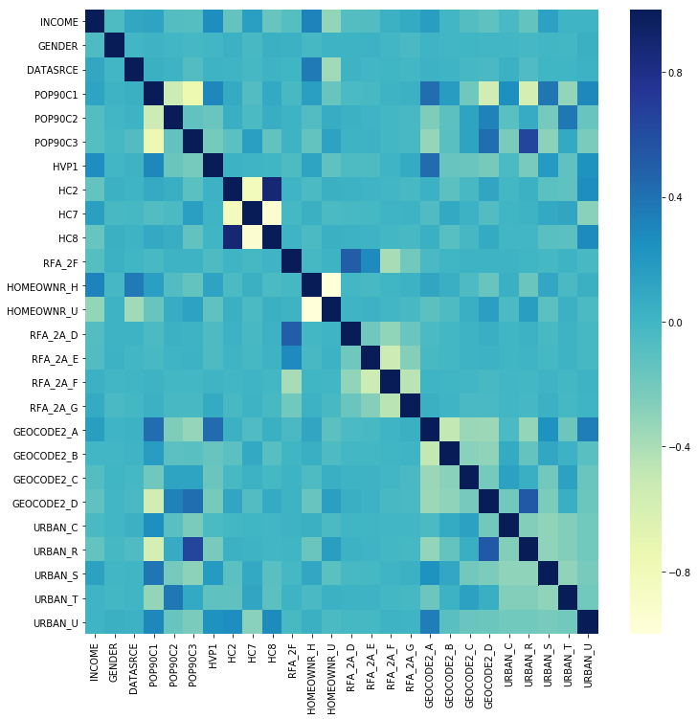
Feature Selection
Feature Selection leads to 26 features in final model

Slide 7
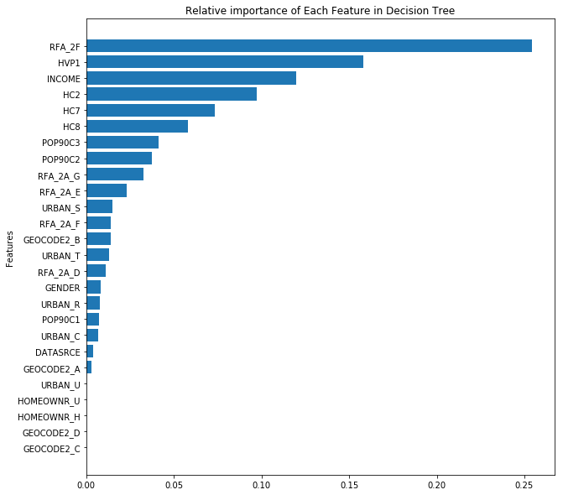
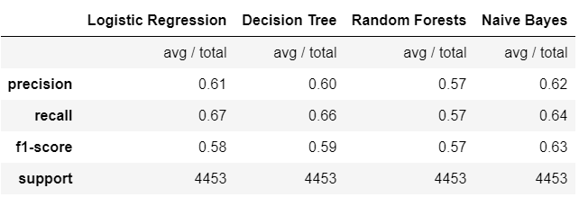
Task 1 – Classify Donors. Vs. Non-Donors
F1 score ranges from 0.57 to 0.63 across all classifiers
Naïve Bayes seems to be the best
Most important features predicted by Decision Tree:
Frequency of donations in most recent period
Percent home value >200k
Income

Slide 8
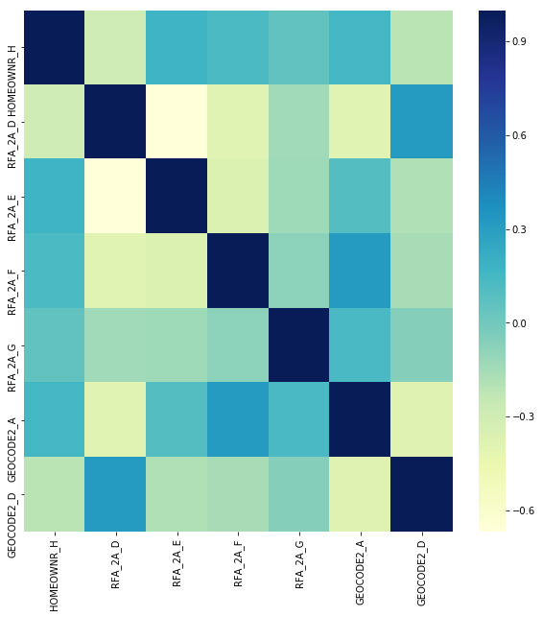
Task 2 – Predict Amount of Donations
Performed RFE again to select the best features needed for regression models → 7 features are selected.

Slide 9
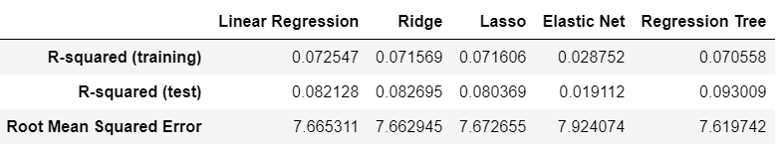
Task 2 – Predict Amount of Donations
Overall low R-squared across all models (range from 0.02 to 0.09)
Regression Tree seems to be the best.
Amount of most recent donation (RFA_2A_D & RFA_2A_G) are predicted to be the most important features by all models.

Slide 10
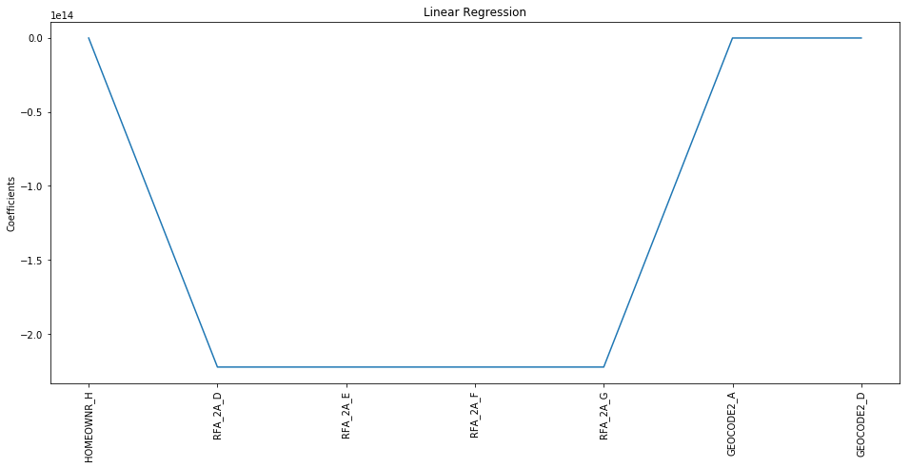
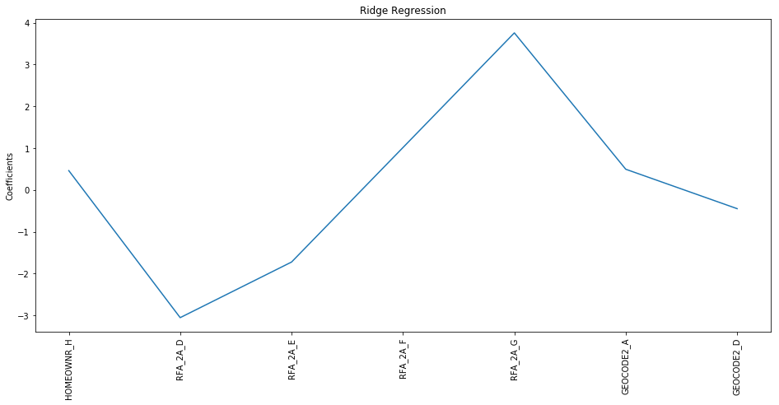
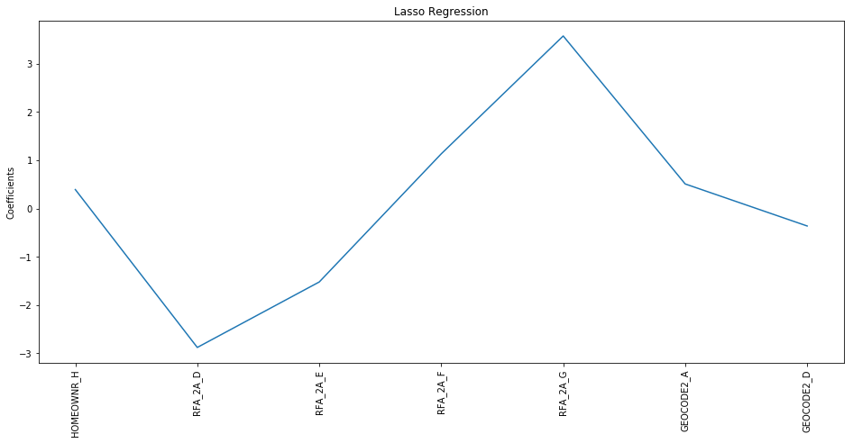
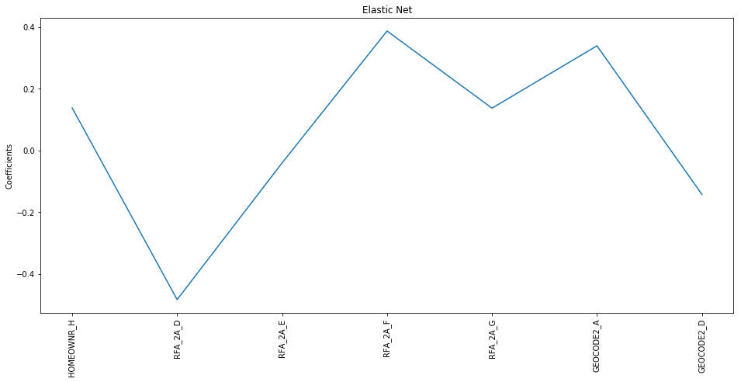
Compare Importance of Coefficients Across Regression Models

